Slide 1
Airline Project
Zhengyong Chen, Xiangsen Dong, Xupeng Tang, Zhaoqing Wu

Slide 2
Overview
Data Collection & Cleaning
Data Modeling
Shiny App

Slide 3
Data Collection & Cleaning

Slide 4
Data Collection
We collected flight data from Bureau of Transportation Statistics, and gathered weather data from National Centers for Environmental information based on airports' latitude and longitude.

Slide 5
Data Cleaning & Merging
Excluding data during the COVID period and flights without matching weather stations or without hourly weather data.
Imputing missing weather values via forward filling before merging and KNN(N=5) after merging.
Converting departure and arrival times to CST. In the first two models, departure and arrival times were categorized by periods of the day.
Adding a Holiday period variable to indicate departures during Thanksgiving, Christmas, or New Year's.
We merged the flight data with the weather data based on the columns for departure airport, arrival airport, and scheduled departure time (CST).

Slide 6
Model 1：Flight Cancellation Prediction

Slide 7
Data Overview
Our data contains 7,248,726 records regarding 378 airports.
We considered cancelled flight as outcome and 32 predictors:
Flight features: Month, Day of Week, Departure Time, Arrival Time, Holiday_Period, Operating Carrier, Origin, Destination, CRS Elapsed Time, Distance
Weather features(Origin and Destination): Dew Point Temperature, Dry Bulb Temperature, Precipitation, Pressure Change, Pressure Tendency, Relative Humidity, Sea Level Pressure, Station Pressure, Visibility, Wet Bulb Temperature, Wind Speed
We used One-Hot Encoding for categorical variables.

Slide 8
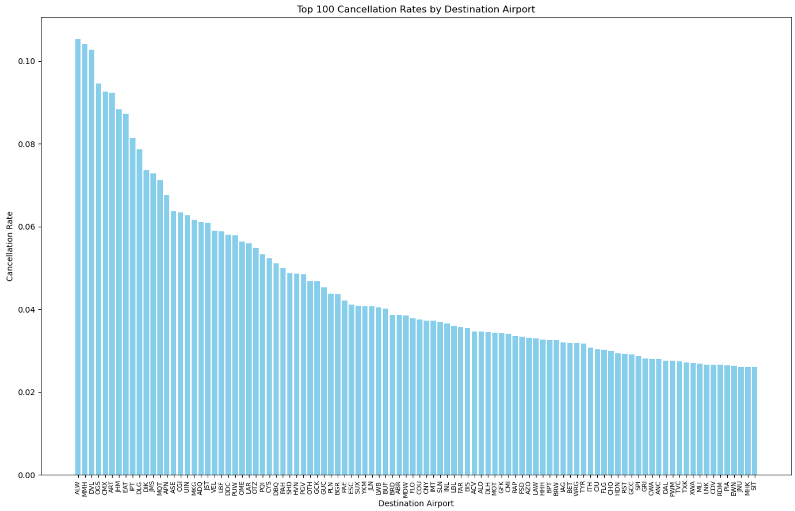
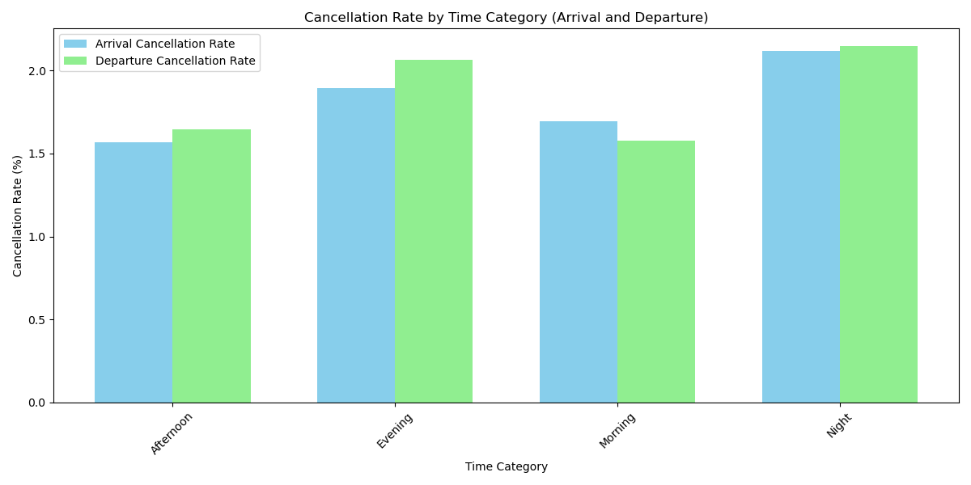
Exploratory Data Analysis

Slide 9
Problem to Solve: Data Imbalance
Only 1.73% of flights are cancelled, data imbalance was a major issue.
A logistic regression model fitted on this data yielded 99.98% prediction accuracy for non-canceled flights(negative samples) but only 1.45% for canceled ones(positive samples).

Slide 10
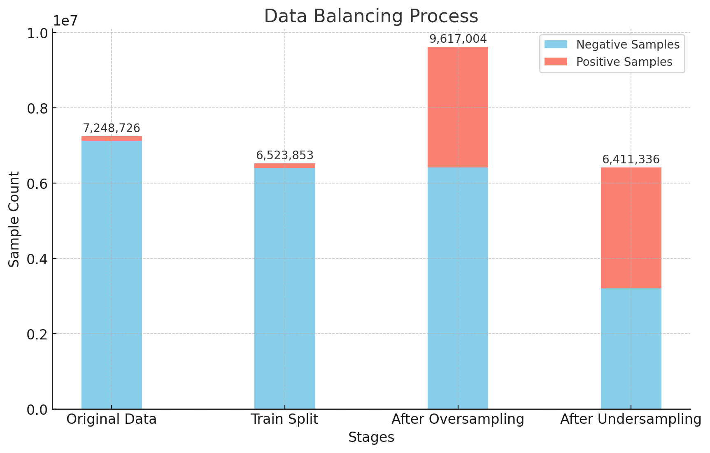
Data Balancing
Splitting training and test set (9: 1)
Oversampling on the training set to increase positive samples to half the number of negative samples
Undersampling to achieve a 1:1 ratio

Slide 11
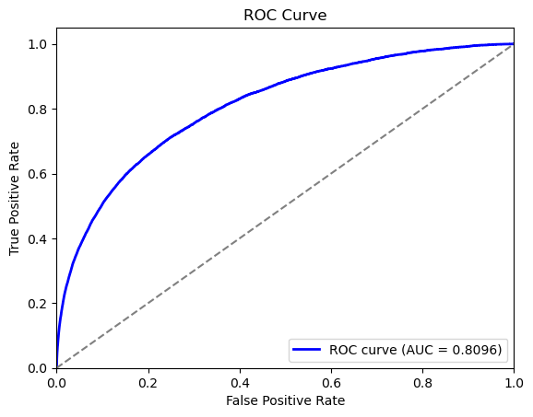
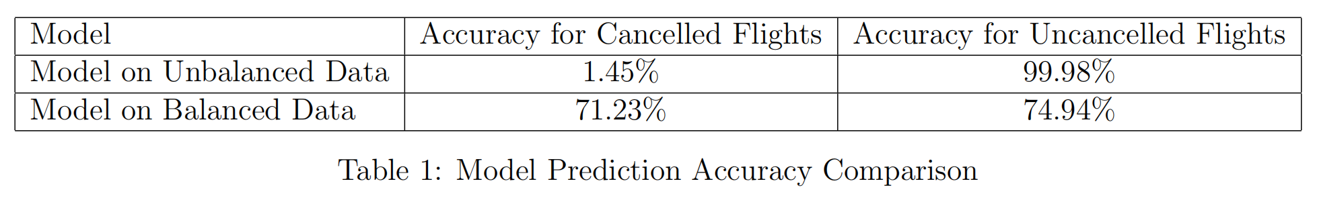
Logistic Regression
The logistic regression model trained on the balanced dataset shows a significant improvement in prediction accuracy for positive samples.

Slide 12

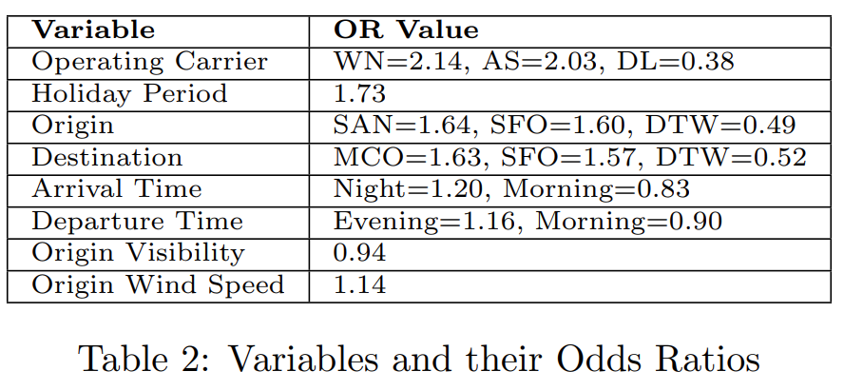
Odds Ratio
OR>1 : the variable raises the odds of cancellation
OR<1 : the variable reduces the odds of cancellation

Slide 13
Tips to avoid cancelled flights
Choose Delta Air Lines
Travel outside holiday periods
Select morning flights
Avoid popular tourist destinations(like Orlando and San Francisco)
Opt for days with high visibility and low wind speeds

Slide 14
Model 2:Flight Delay Prediction

Slide 15
Data Overview
Our dataset contains 7,248,726 records from 378 airports.
We considered cancelled flight as outcome and 32 predictors:
Flight features: Month, Day of Week, Departure Time, Arrival Time, Holiday Period, Operating Carrier, Origin, Destination, CRS Elapsed Time, Distance
Weather features(Origin and Destination): Dry Bulb Temperature, Precipitation, Relative Humidity, Sea Level Pressure, Station Pressure, Visibility, Wind Speed

Slide 16
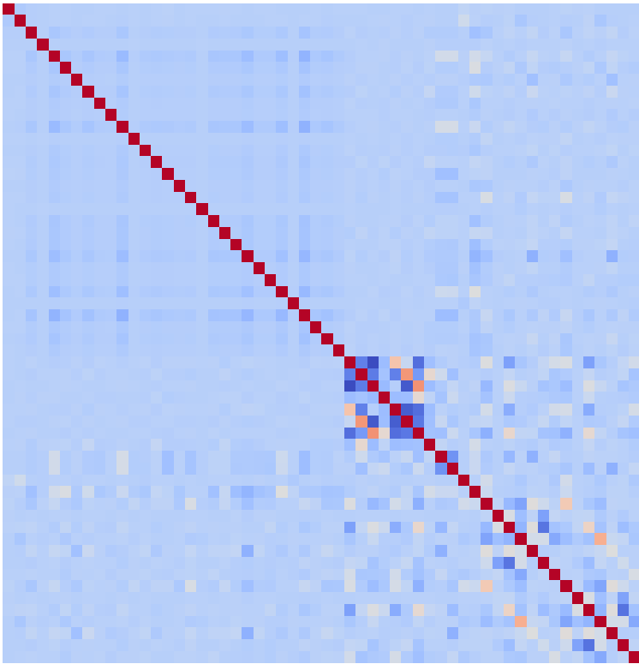
Correlation Checking
Heatmap of variables’ correlation

Slide 17
Categorical data processing
 | One hot encoder | Frequency encoder
Strength | Information preserving Easy to handle | Efficient
Weakness | Increase number of features Low efficiency | Information loss

Slide 18
One hot encoded variables | Frequency encoded variables
Operating Carrier, Time period, Day of week | Airport

Slide 19
Influencing variables
Most significant | Moderately significant | Least significant
Origin_Visibility Origin_Dry Bulb Temperature Dest_Visibility Operating Carrier_DL Dest_Wind Speed | Origin_Wind Speed Operating Carrier_HA Arrival time_Morning Arrival time_Evening Dest_Relative Humidity Origin_Precipitation Dest_Precipitation | Airport, Station_Pressure SeaLevel_Pressure

Slide 20
Tips to avoid flight delay
Choose Delta Airlines
Travel on a warm, clear day
Avoid windy or rainy days
Avoid Hawaii Airlines

Slide 21
Model metrics
Accuracy: 0.5887
Precision: 0.4487
Recall: 0.5679
F1 Score: 0.5013
ROC AUC: 0.6192
Average Precision: 0.4833

Slide 22
Model 3 : Delay Time prediction

Slide 23
Feature
Weather feature: Almost all weather features except weather type
Airline feature:
Operating Carrier(encoded)
Distance (numeric)
Location feature:
Longitude/Latitude (numeric)
Origin/Destination Airport (encoded)
Time feature:
Month/Day of the week(encoded)
Date/Date_CST (Here, I should have encoded the hours, but I processed them as continuous data)

Slide 24
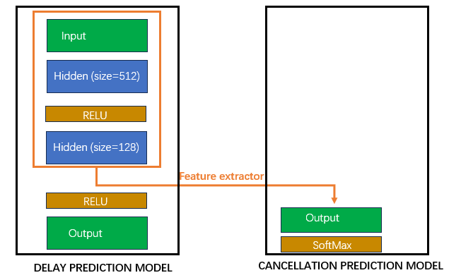
Model structure

Slide 25

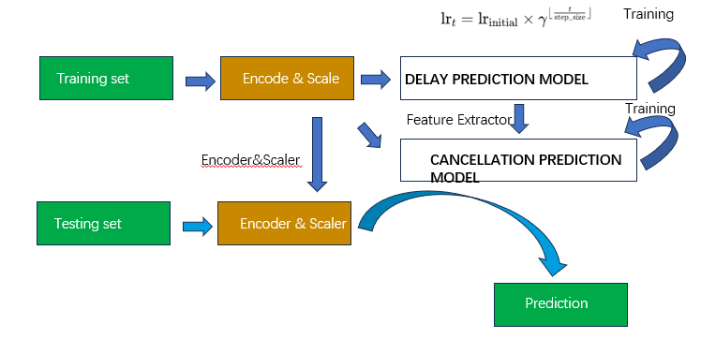
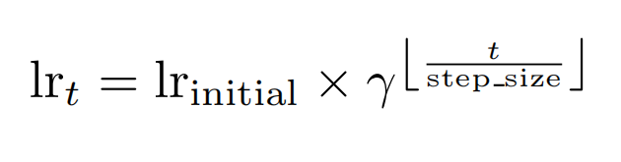
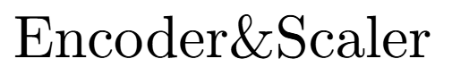
Process

Slide 26
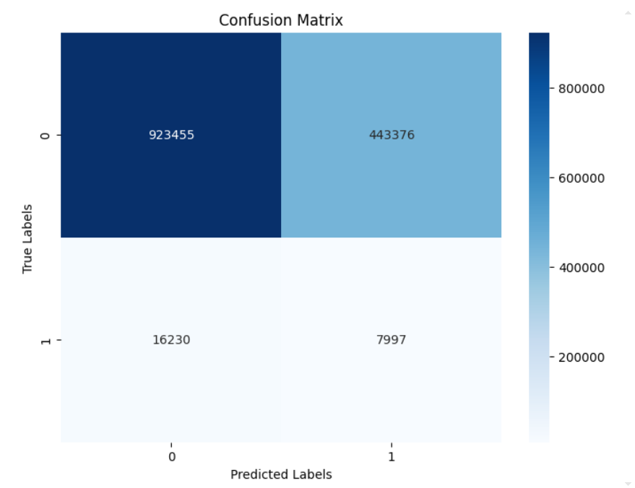
Results
Our delay prediction neural network reached an RMSE of 39 minutes on the test set.
Our combination flight cancellation prediction network reached recall (0.6756) for cancelled case and recall (0.3301) for uncancelled case.

Slide 27
Strength and weakness
Advantages:
Our method can reduce the cost required to train classification models.
Our model architecture can be easily expanded and has great potential.
Disadvantages:
The performance of our model is not sufficient. We should add more layers.
Poor interpretability.

Slide 28
Torch model to skearn model
Question Statement:
Our online Shiny application needs to call an online Python environment, but Shiny for Python does not have the PyTorch package pre-installed.
Every time we download the PyTorch package online, the environment gets cleared when the webpage is closed.
Proposal Step:
Step1 Redefine the model using sklearn's neural network implementation.
Step2 Extract all the parameters from the PyTorch model, convert them to arrays, and import the parameter arrays into the sklearn model.

Slide 29
Shiny App

Slide 30
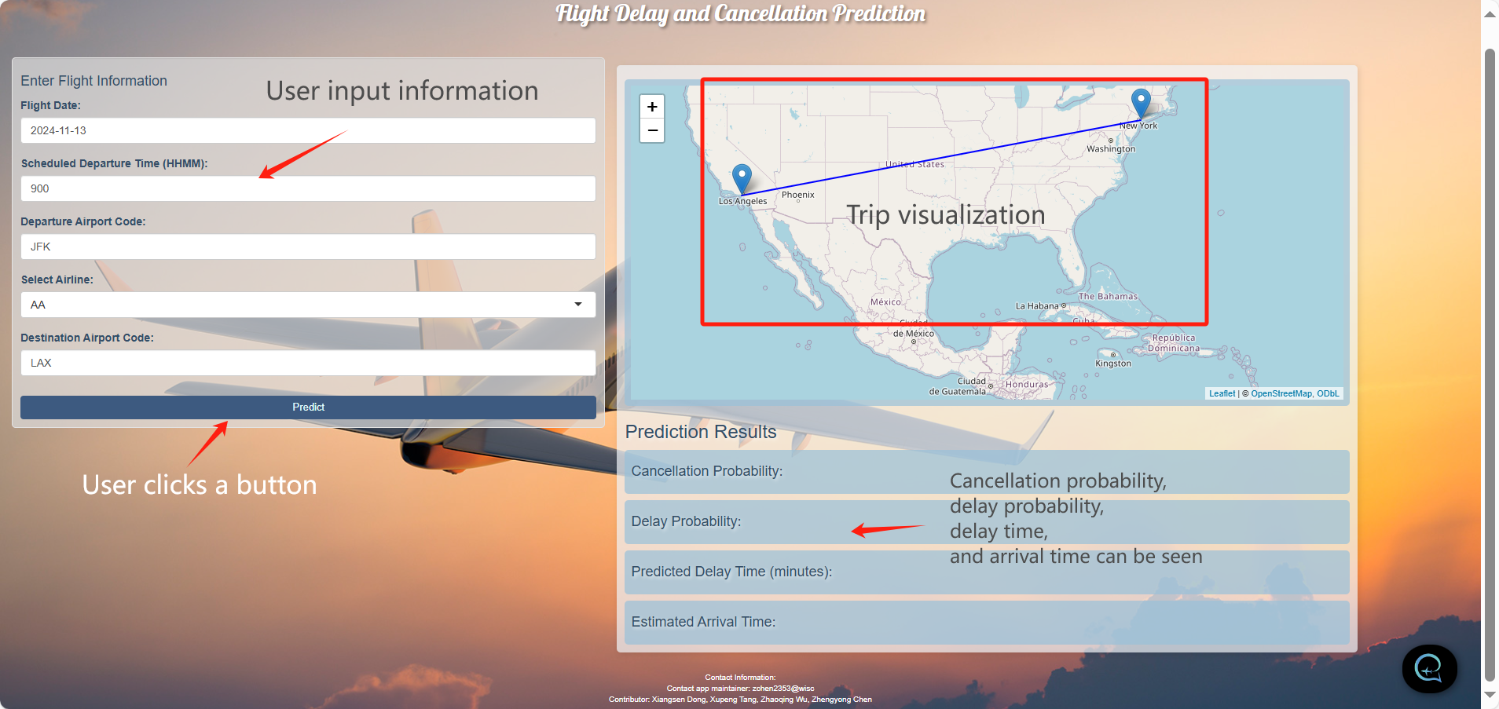
Shiny App - Flight Delay and Cancellation Prediction https://andrewchanshiny.shinyapps.io/Group10_P3/

Slide 31
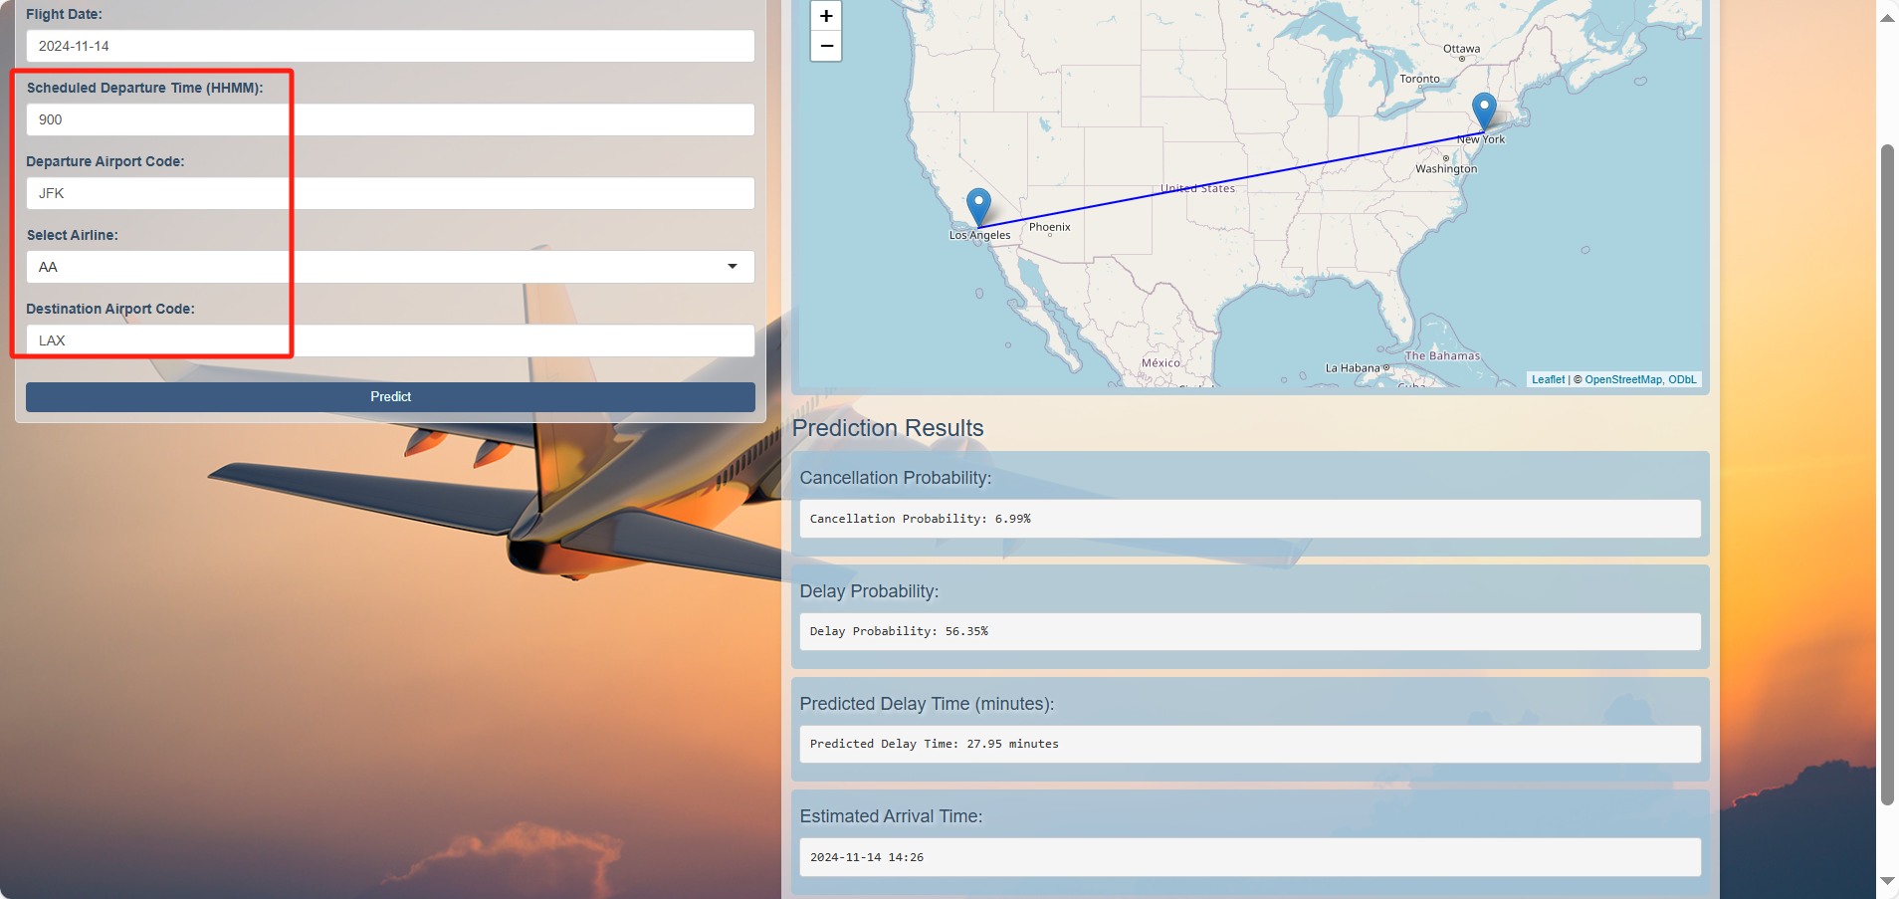
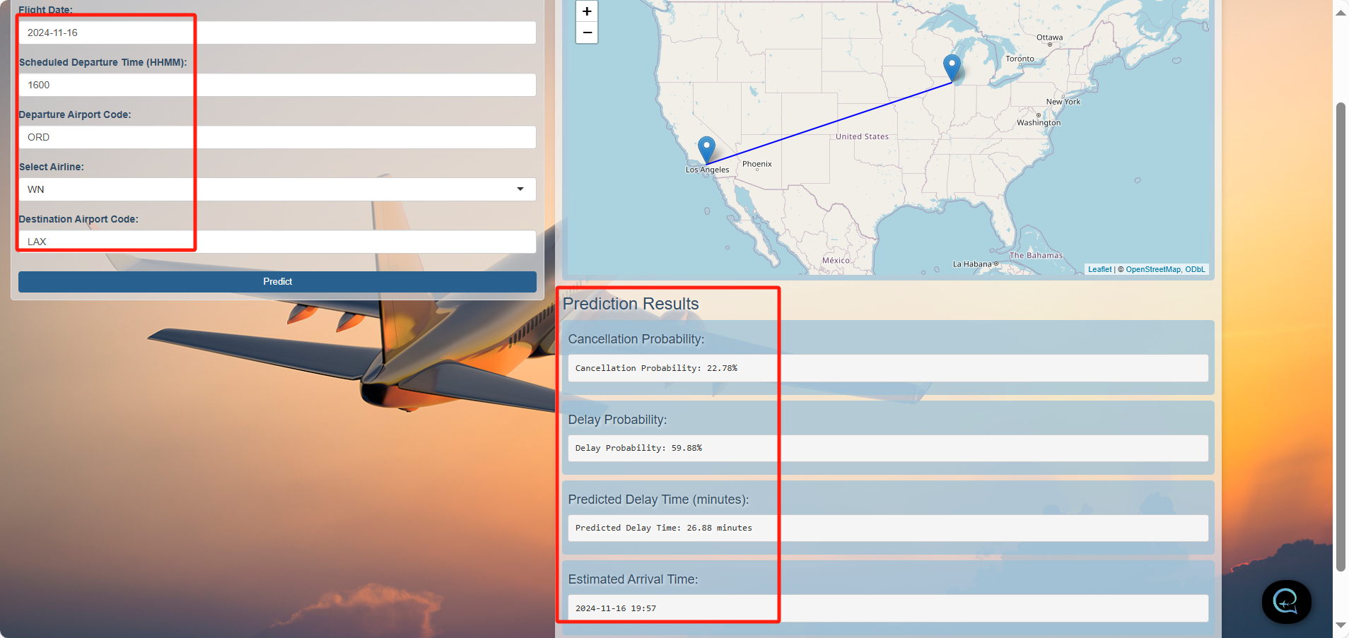
Shiny App - Flight Delay and Cancellation Prediction https://andrewchanshiny.shinyapps.io/Group10_P3/
Thanks for listening

Slide 32
Thank you!

